Slide 1





Acumen Partner to Your Business
Gurugram | Delhi | Bangalore | London | Dubai | Delaware
www.corpacumenglobal.com | global@corpacumen.com
+91-9873191956 | +91-9650862933 | +91-8800543810
+971-585372740 | +971565685984
Notes:
Smiley face (African American female)and growth chart

Slide 2




About Us
CorpAcumen Global is a multi-disciplinary consultancy firm founded by proficient and seasoned professionals having years of experience in serving diversified industries.
We render extensive services in into the fields of Financing & Accounting, Mergers & Acquisitions, Business Set Ups, Valuation & Financial Modelling, Risk & Auditing, Corporate Taxation, Legal & Regulatory Governance including Foreign Exchange & Company Law, Due Diligences, Data Protection, Intellectual property protection, etc.
We believe in building ever-lasting relationships, which are mutually beneficial and based on a strong foundation of trust, faith and supreme professionalism.
Being a one stop solution for all the corporate needs, we carry a holistic approach towards a problem and with our cross functional expertise we are able to provide comprehensive solutions, better communication and reduced risk for our clients.

Slide 3

Our Services
Business Set up services
Employment and Labour Laws
Transaction Advisory and Corporate M&A
Data Protection Laws
Private Fund – Equity and Debt
Dispute Resolution including ADR
Joint Ventures and Strategic Alliances
Commercial Contracts
Corporate and Commercial
Partners/Shareholder Rights and Disputes
Capital Investment
Regulatory approvals and audit
Intellectual Property Protection Laws
Shared Services (Contracts Review and Advisory)

Slide 4

Business set up Solutions
The Firm provides comprehensive business setup services in more than 25+ jurisdictions around the world, along with allied services necessary for the commencement of business operations.
Company/ Entity Formation
Licensing and Registrations
Global and local Tax and VAT Advisory
Book Keeping and accounting
Nominee director/ secretary/ shareholder
Office space facility
Visa and Immigration
Secretarial services
HR and Payroll management
Bank account opening

Slide 5

Accounting & Finance Outsourcing
The firm has rich experience in delivering comprehensive solutions to its clients in all their transaction-based affairs. The services offered by the firm include the following:
Virtual official Services | Book Keeping Services | Invoice Processing Services
Payment Processing Services | Fixed Asset Management Services | Taxation & Substitute Preparation Services
Compliances | Payroll Processing Services | Professional Manpower Outsourcing

Slide 6
Transaction Advisory
Services,
Corporate M&A, Private Equity Venture Capital
The firm has rich experience in delivering comprehensive solutions to its clients in all their transaction-based affairs. The services offered by the firm include the following:
Legal, Financial and Tax Due Diligence Services | Acquisition, Divestments, Buy Back and Takeover | Merger & Amalgamation, Divestitures & Spin Offs, Demergers and Hive off
Cross Border Transaction/ Investment Structuring | Transaction Structuring for Primary Investments | Documentation and other transaction support
Deal Negotiation & Joint Venture Advisory | Succession Planning | Capital and Debt Restructuring
Organic Expansion Planning | Inorganic Expansion Planning | Exit Strategy Advisory
Business and Asset Transfers​ | Public and Private Debt and Equity Offerings​ | Sale and Purchase of Distressed Assets​

Slide 7

Fund Raising - Private Equity
Our private equity advisory services surpass standard norms, emphasizing the criticality of securing the right investor on par with obtaining the precise capital quantum. Capitalizing on robust affiliations with eminent Global Investment Banks, Angel Investors, Venture Capital Funds, and Private Equity Funds, we deliver an exhaustive array of support. Whether the demand pertains to angel investment, seed capital, venture capital, or strategic investment, our pledge is to furnish clients with a meticulously chosen cadre of astute investors tailored to their distinct requirements.
We meticulously craft Information Memoranda and essential documents for submission to prospective investor
Taking a proactive role, we engage in discussions and articulate the investment opportunity on behalf of our clients
Employing strategic and thorough negotiation techniques, we aim to secure favorable valuations and terms for our clients
The deal structuring process involves selecting the most suitable financial instruments to establish a mutually beneficial arrangement for both our client and the investor.
Our involvement extends to aiding in investment due diligence and ensuring compliance with regulatory requirements
We provide guidance on the selection and preparation of pertinent transaction documents and agreements, ensuring the successful execution of the transaction

Slide 8
Fund Raising -Debt
We specialize in delivering top-notch services covering a broad spectrum, including fund raising at both domestic and international levels, meticulous fund management, intricacies of security structuring, adept navigation through complex financial landscapes, and effective debt management strategies.
  Our expansive network fosters robust relationships with banks both in India and around the world
  Our comprehensive services begin with a thorough assessment of fund requirements, involving in-depth analyses of creditworthiness, collateral evaluation, and cash flow dynamics
  We strategically identify credit types and map potential lenders, ensuring a tailored approach that aligns with our clients' financial goals.
  Our proficiency extends to the meticulous preparation of teasers, information memorandums (IMs), and financial models, presenting a compelling and thorough representation of our clients' financial positions.
  We provide valuable assistance in obtaining credit ratings, leveraging our expertise to optimize our clients' credit profiles.
  We handle the negotiation phase with strategic finesse, engaging with lenders and investors to secure favorable terms for our clients.
  Post-disbursal, our services include managing formalities and maintaining proactive relationship management, ensuring ongoing success and satisfaction for our clients throughout their financial journey.

Slide 9

Joint Ventures and Strategic Alliances
We understand that Joint Venture and Strategic Alliance transactions mandate lawyers to understand more than just the legal issues. Our team is sensitive to the cultural differences of all the parties to the transactions and we strive to be respectful to such cultural differences at the time of acting for our clients. Often Joint Venture and Strategic Alliances involve agreement on ancillary issues such as technology transfer & licensing, sale and purchase of goods & services, secondment of employees, confidentiality and non-disclosure requirements, and others that require a diligent and careful approach. We have experience of acting for clients, both domestic and transnational, from varied industries and sectors.
Share Purchase, Share Subscription and Shareholders' Agreements
Drafting Prospectus, Information Memorandum, Letter of Offer
Technology transfer and technology sharing agreements
Intellectual Property Rights licensing/ assignment agreements
Employment agreements
Non-disclosure and confidentiality agreements
Non-compete agreements
Other Service, Business or Commercial agreements

Slide 10

Corporate and Commercial
We regularly advise our clients on general corporate matters and help them with drafting/reviewing of their commercial agreements. We offer customised industry-specific legal compliance systems and internal legal audit to keep the management informed about the status of legal compliance within the organisation. We extend our support in the form of day to day legal advice on corporate, regulatory and governance matters.
Industry-specific legal compliance system
Obtaining registrations, licenses, approvals, permissions, etc from government authority and regulator
Assistance in secretarial compliance/ retainerships
Legal audits and due diligence
Drafting, negotiation and finalization of various agreements
Incorporation and closure up of companies

Slide 11

Capital Investments
We have extensive experience of advising clients on exchange control laws and facilitate foreign investment in a seamless manner. From advising and representing our clients in ensuring hurdle free entry services.
Regulatory approvals from Industry Regulator
Compliance and reporting
Global business setup
Entry strategy and transaction advisory & assistance
Legal Opinions
Representations and Appeals
Audit and assurance

Slide 12

Employment and Labour Laws
We work with our clients in resolving the issues in and optimising their employment and labour structures to provide long-term solutions. We also possess rich experience in creation of internal HR and reporting policies, drafting of employment agreements and employee handbooks, and creation of internal compliance management systems.
Employment agreements and employment handbook
Non-disclosure agreements, confidentiality agreements, non-compete agreements
Advisory and strategy
Disciplinary proceedings and statutory policies
Complaint mechanism
Labour disputes and litigation
Audit & due diligence
Compliance management
Employee benefits & compensation structuring
Employment termination & downsizing
Expatriate advisory & Immigration
Exits and Separation agreements
Contract labour / Alternate employment arrangements

Slide 13

Data Protection Services
Data protection and privacy laws are relatively evolving but are fast-paced. Companies often find it difficult to comprehend the legalities involved, and therefore, often find themselves vulnerable. Our team has been at the forefront in decoding the ever dynamic data protection and privacy laws. The firm has constantly been advising its clients, both domestic and international, with their complex queries, and also providing them related varying services.
Setting up of Data Privacy process commensurate with the objectives of the Company
Framing a comprehensive mechanism for the Company
MIS for ensuring efficancy
Impact Assessment
Organizing Data Privacy training and awareness program
Data Privacy Audit

Slide 14

Dispute Resolution
We represent our clients for the effective and timely resolution of their disputes in various courts and tribunals. We have long-standing associations with experienced legal professionals across the Global business jurisdictions and beyond to represent our clients and efficiently handle their disputes not only in different parts of India but also overseas through our Associate Network.
Commercial disputes | Company Litigation | Civil Litigations | Debt Recovery
Tax Litigations | Contractual Disputes | Corporate matters | Employment & Labour Disputes
Consumer Disputes | Public and Administrative Law | Criminal matters | Family Disputes and Settlement

Slide 15

Partners’/ Shareholders' Rights and Disputes
We have been representing the clients through our associate in a multitude of cases involving a violation of rights of stakeholders, oppression and mismanagement, unlawful actions by the management of a company, or violation of an agreement by any counterparty. We have been representing shareholders through our associates before various judicial and quasi-judicial forum while also providing continuous advisory services.
Mismanagement cases
Representation before authorities
Joint Venture Disputes
Investment Disputes
Breach of other enforceable agreements
Drafting of applications, petitions and other documentations

Slide 16

Alternative Dispute Resolution
We have rich and varied experience in conducting international and domestic arbitration under both Institutional and Ad-hoc Arbitration for our clients. We have successfully represented our clients in several international arbitrations. We regularly advise our international clients on their corporate dispute in view of best international arbitration practices and international laws and treaties.
Representation before international arbitration tribunals
Representation before Institutional and Ad-hoc arbitration tribunal
Drafting of applications, claims, counter-claims & other documentation involved
Mediation services
Advisory services
Conciliation services

Slide 17




Our value proposition
Rich
Expertise
Research Division Advisory
Our Team Combination
One Umbrella Services
Our team comprises of optimum combination of Professionals having rich expertise and relevant experience
Our advisory is backed with comprehensive research. Our team provides insights with deeper perspective in creating a plethora of opportunities for the clients.
Our multidisciplinary team comprises of people from different backgrounds to provide fully integrated and a professionally managed solution to the clients for their end to end needs.
We at CorpAcumen provide range of financial and business consulting services. Further we through our associate Law Firm, Acumen Juris, provide extensive legal Services

Slide 18


Our Associate Network
UAE
USA
UK
Mexico
Brazil
Spain
Saudi Arabia
Singapore
Canada
Switzerland
Indonesia
Hong Kong
Vietnam
Nigeria
Mozambique
Malaysia
Cambodia
Argentina
Germany
France
Italy
Cayman Island
Sweden
Denmark
Bangladesh
Mauritius
Nepal
Philippines
Netherlands
Kenya

Slide 19

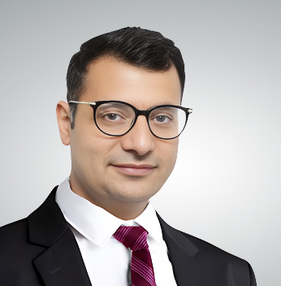
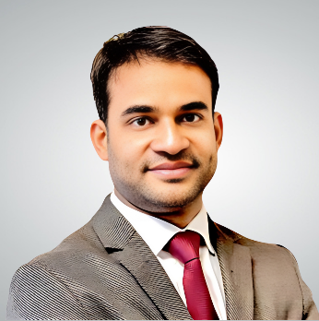
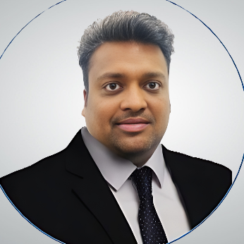
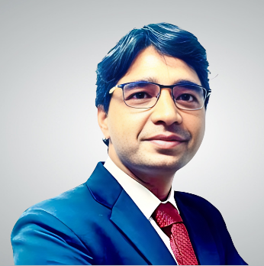




Our Team
Ashish Goyal
Govind Rishi
Abhishek Bansal
Manish Dubey
He is an advocate with 16 years of experience. He specializes in litigation, arbitration, and corporate consultancy, serving diverse industries including manufacturing, IT, real estate, infrastructure, banking, telecom, aviation, energy, and retail. He is a panel advocate for Punjab National Bank and NBCC India Limited, and he heads the firm's insolvency practice.
He is specialized in International Arbitrations and Dispute Resolution.
Abhishek Bansal, a law graduate from the University of Delhi with 16 years of experience, specializes in cross-border investment, legal due diligence, corporate structuring, and competition law. He has served various sectors and co-authored a book on Companies Act 2013, and developed www.femaindia.in, the only website on Foreign Exchange Laws in India.
He is specialized in setting up business structures in more than 25 Global Business Jurisdictions
Chartered Accountant with 15 years of experience specializing in Direct and Indirect Taxes, tax planning, and representing clients in tax litigation. Certified Concurrent Auditor of Banks with ICAI. Served sectors including Retail, Manufacturing, Banks, Hotels, Education, and Housing Societies. Expert in preparing project reports and representing clients for bank facilities.
He is specialized in tax advisory and compliance for UAE and India.
He is fellow member of ICAI, having 15 years of experience in providing end-to-end solutions in direct & indirect taxation.
He is deeply passionate towards start-ups and has been credited with accelerating the growth of various start-ups.
He is specialized in tax advisory and compliance for USA, UK, KSA, and India
govind.rishi@acumenjuris.com​
abhishek.bansal@acumenjuris.com
ashish.goyal@acumenjuris.com​
manish.dubey@corpacumen.com
+91-98180 40003
+91-9873191956
91-99994 61827
+91-90136 55536
Govind Rishi - Managing Partner –
ACUMEN JURIS | LinkedIn
+971-5853 72740
CA Ashish Goyal - Partner –
CorpAcumen Advisors LLP | LinkedIn
CA Manish Dubey - Founder Partner –
Corpacumen advisors LLP | LinkedIn
Abhishek Bansal - Acumen Juris, Law Office | LinkedIn

Slide 20
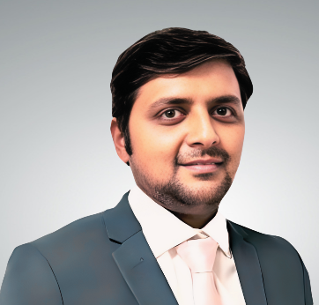
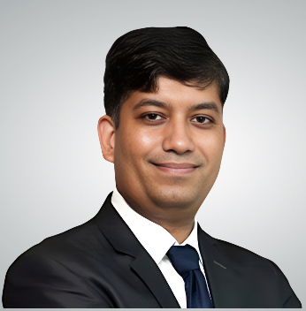
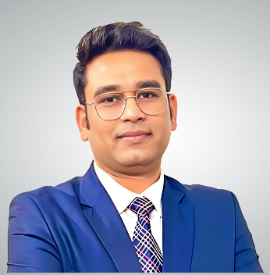
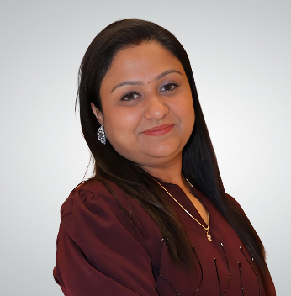
Our Team
Gaurav Mittal
Preeti Goyal
Abhishek Chaurasia
Atul Maheshwari
He is having more than 15 years of experience in M&A, Business Valuations, Transaction Advisory and Investment Banking.
He is an alumnus of Price Waterhouse Coopers and a Delhi based SEBI Registered (Cat 1) Merchant Banker.
He is specialised in undertaking business valuations in more than 25 Global Business Jurisdictions.
Chartered Accountant with more than 18 years of finance experience. Expertise in fund raising (Domestic/ International), debt management, addressing security structure, working capital management, strategy and compliance, finance cost management, business plans.
Atul, a Chartered Accountant with more than 16 years of experience, is an alumna of Barclays and Moody’s. He is well-connected with leading global banks, VCs, PE firms, and HNIs across the globe . Currently, he plays a pivotal role in providing guidance to organizations globally in their fundraising initiatives. His expertise lies in both debt solutioning for conglomerates, facilitating PE for VCs/ PE firms and startups, and providing IPO support.
Preeti, a University of Delhi graduate and fellow member of the Institute of Chartered Accountants of India, has over 13 years of experience in Secretarial practice, Direct and Indirect Tax, TDS compliance, MSME Act, Bank Audits and Trade Mark Registrations.
She is also actively involved in various professional groups and associations.
abhishek.chaurasia@corpacumen.com
gaurav.mittal@corpacumen.com
atul.maheshwari@corpacumen.com
Preeti.goyal@corpacumen.com
+91-95405 48383
+91-98713 12275
+91-98994 11585
91-9810180456
Abhishek Chaurasia - Partner - CorpAcumen Advisors LLP | LinkedIn
Gaurav Mittal - Partner at CorpAcumen - CorpAcumen Advisors LLP | LinkedIn
Atul Maheshwari CA, B Com - Partner - CorpAcumen Advisors LLP | LinkedIn

Slide 21
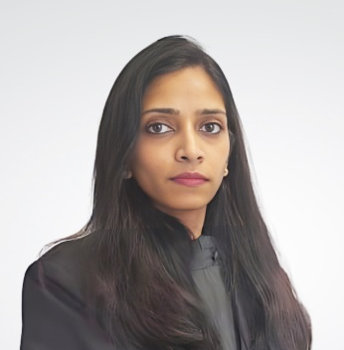
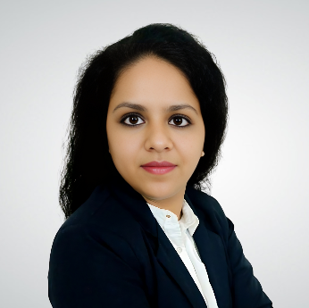
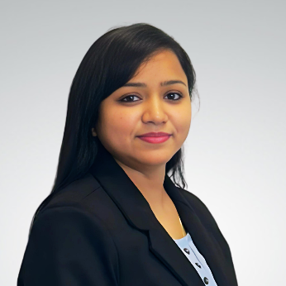
Our Team
Why Us
Years of Experience
Customized Solutions
Strategic Counselling
Transparency
Accountability
Nidhi Choudhary Khandelia
Iram Naaz
Laxmi Sinha
A peer-reviewed Practicing Company Secretary, a Law Graduate, and a Certified POSH Trainer. She has rich experience and expertise in corporate transaction and legal advisory, legal due diligences, secretarial and compliance audits, cross-border transactions, global and Indian business setup, approvals and registrations under securities laws along with various reporting requirements.
A Company Secretary and law graduate specializes in corporate laws, capital markets, and corporate governance.
She has extensive experience in India entry and global business setup, especially in Kingdom of Saudi Arabia.
She has served various sectors and authored articles on fundraising and SEBI compliances.
A Company Secretary and law graduate, specializes in Corporate transactions, global business setup, cross-border transactions, and sector-specific laws. She advises on corporate laws worldwide, represents clients before judicial bodies, foreign exchange laws and provides legal opinions.
She specializes in setting up businesses in more than 25 Global Business Jurisdictions.
nidhi.choudhary@acumenjuris.com
iram.naaz@acumenjuris.com
laxmi.sinha@acumenjuris.com
+91-98997 22099
+91 75031 68415
+91-96508 62933
Nidhi Choudhary Khandelia - Proud Member - Pink & Blue- A Symbiotic Living | LinkedIn
IRAM NAAZ - Principal Associate - Corporate & Commercial Laws - ACUMEN JURIS | LinkedIn
Laxmi Sinha - Principal Associate - ACUMEN JURIS | LinkedIn

Slide 22

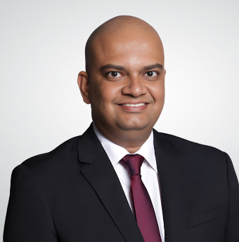
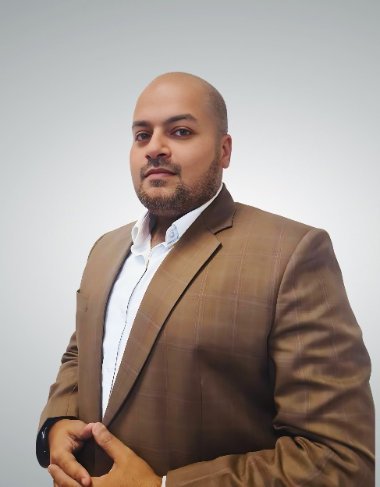
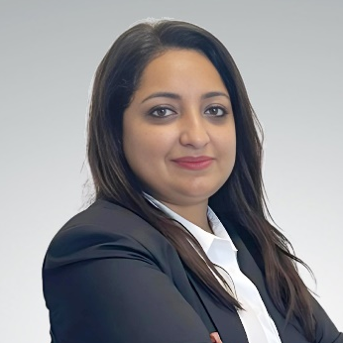
Our Global Partners
Nitin Goswami
Dinesh Dahiya
Kiran Sreedharan
Siddhi Anand
A fellow member of ACCA and holds a certification as a Decentralised Finance (DeFi) expert from the Blockchain Council. He is an ECB-approved Executive Director with over 17 years of experience in European Fin-Tech, specializing in Crypto and Blockchain advisory services.
Dinesh supports Crypto and Blockchain companies in setting up operations in the UAE and Europe, and sits on the boards of successful projects in various roles.
A Fellow Member of the ICSI and an Associate Member of the ICAS and a fellow Member of the Chartered Institute of Arbitrators and the Singapore Institute of Arbitrators, holds experience in cross border acquisitions, expanding businesses, starting new ventures, fund raise, listing compliances
He provides his expert assistance on starting, scaling and saving businesses across Asia, Middle East and Africa.
Nitin Goswami leverages his unique blend of business acumen and technical expertise to empower entrepreneurs. With over 8 years of experience, he guides clients in the US and Canada through the intricacies of business setup, registration, licensing, and tax compliance. His services extend to safeguarding intellectual property on a global scale, specializing in trademark protection.
A Company Secretary with a Masters in Business Law from NLSIU, specializes in Corporate & Commercial Advisory, Joint Ventures, Intellectual Property Laws, and India Entry Solutions. She has extensive experience in setting up virtual data rooms, conducting due diligence, and drafting agreements.
She specializes in setting up businesses in UAE.
global@corpacumen.com
global@corpacumen.com
nitin.goswami@corpacumen.com
siddhi.anand@acumenjuris.com
+353 879876509
+65 8808 3808
+91 83830 78983
+91-88005 43810
Dinesh Dahiya - OpenZeppelin | LinkedIn
Nitin Goswami - Director Of Operations - CorpAcumen Global | LinkedIn
Siddhi Anand | LinkedIn

Slide 23






























Clients

Slide 24






























Clients

Slide 25


Our Offices
Gurugram Ofﬁce
B - 681, 2nd Floor, Sushant Lok – 1, Sector – 43, Gurugram – 122022
United States of America Ofﬁce
8, The Green, Ste B, Dover, Delaware – 19901, USA
United Kingdom Ofﬁce
Suite S2, 3 Trinity Garden, 9-11 Bromham Road,
Bedford, England, MK40 2BP
Delhi Ofﬁce
B4/170 Ground Floor, Safdarjung Enclave, New Delhi - 110029
105c, Second Floor, Ekta Enclave, Paschim Vihar, New Delhi 110087
Noida Ofﬁce
B 37, Sector 1, Gautam Buddha Nagar, Noida, Uttar Pradesh - 201301
Europe
Netherlands, Germany, Italy
Americas
Canada, Mexico, Brazil
Asia Paciﬁc
Japan, Singapore, Australia, New Zealand, Indonesia, Laos, Nepal, Philippines, Malaysia, Cambodia, Thailand, Myanmar, Vietnam, Mongolia, UAE
Overseas Associate Offices
Bengaluru Ofﬁce
H. No. 13, 3rd cross, Sandyagappa Layout Marianna Palya, HA Farm Post, Hebbal, Kempapura Bengaluru
UAE Ofﬁce
BC 513, Al Attar Business Centre, Al Barsha 1, Dubai UAE
Scan QR Code to visit our website

